Slide 1
Distributed Task
Execution System
Master–Worker Architecture

Slide 2

System Problem
Desired System Behavior:
Multiple laptops sharing work equally
Balanced load across all machines
No single point of failure
Automatic task distribution
Ideally, all machines in a network should share work dynamically. Tasks should go to the least loaded system, and the system should continue even if one node fails.

Slide 3
Drawbacks previously:
❌ No Decentralized Architecture
Single point of failure (master crash = system down)
Poor scalability & bottleneck at central node
❌ No UDP Gossip (Load Sharing)
No real-time load info
Wrong worker selection → slower executionn

Slide 4
❌ No Fault Tolerance
Task lost if node crashes
No recovery or retry
❌ No Timeout Mechanism
Infinite loops freeze system
Resource blocking
❌ No Proper Network Config (Firewall)
Nodes can’t connect
System fails to operate

Slide 5
Objectives
Eliminate single point of failure (fully decentralized)
Dynamically distribute tasks based on system load
Use UDP gossip protocol for load sharing
Use TCP for reliable execution + result transfer
Implement fault tolerance (node crash recovery)
Prevent system freeze using timeout (infinite loop protection)
Ensure real-time execution (no unnecessary delays)
Also disabling firewall to ensure any device can participate

Slide 6
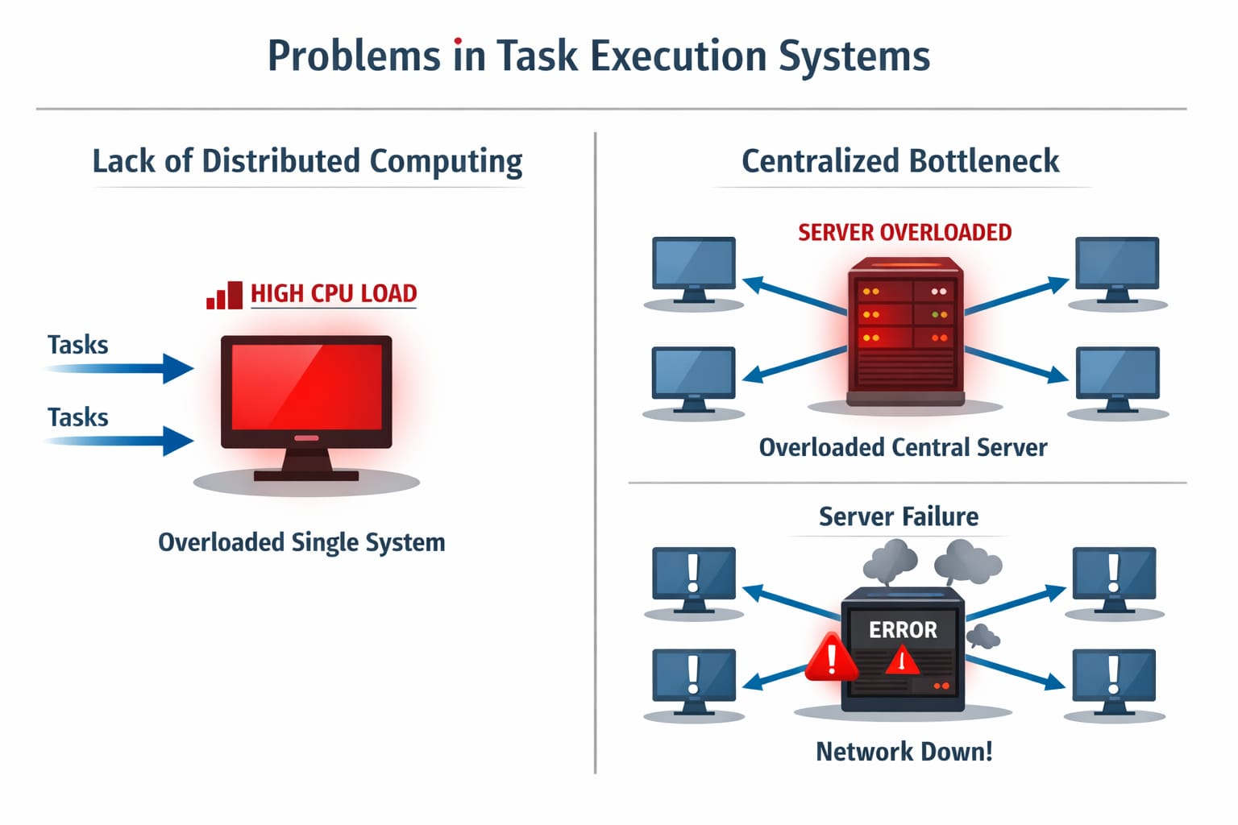

Slide 7
PROPOSED SOLUTION
“Decentralized P2P Task Execution System”
Fully decentralized architecture
Every node = client + server
Dynamic load-based execution

Slide 8
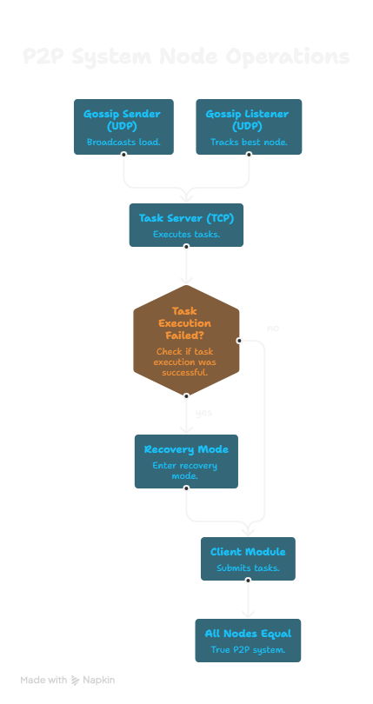
Architecture

Slide 9
KEY FEATURES
1.Gossip-based load sharing (UDP)
2.Load-aware scheduling
3.Fault tolerance
4.Infinite loop protection
5.Real-time execution

Slide 10
SYSTEM ARCHITECTURE
Node A ↔ Node B ↔ Node C ↔ Node D
3 components:
1.Gossip Sender
2.Gossip Listener
3.Task Server
Each node runs three parallel services: one to send load, one to receive load, and one to execute tasks.

Slide 11
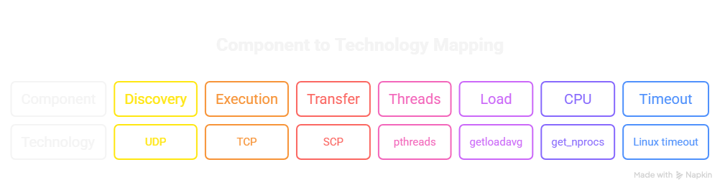

TECHNOLOGIES USED

Slide 12
FAILURE HANDLING
Crash detection
Retry mechanism
Fallback to local execution
Timeout for infinite loops

Slide 13
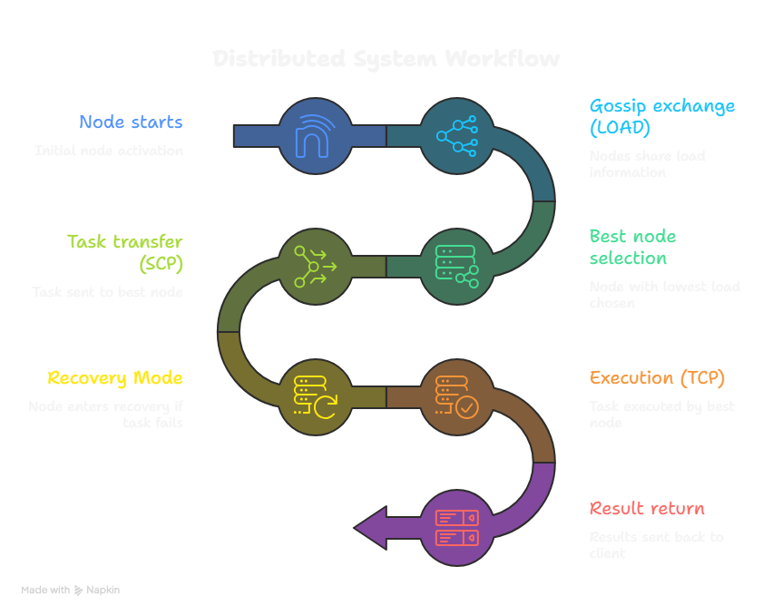
EXECUTION FLOW

Slide 14
CONCLUSION
1.Efficient resource utilization
2.Scalable system
3.Reliable execution
4.We tested multiple scenarios including crashes and infinite loops, and the system handled all cases correctly.

Slide 15
Thanks!

